Slide 1
Service Computing, REST and API

Slide 2
Sources
Software Engineering 10 (Ian Sommerville)
Dr.Thanachart Numnonda
https://www.slideshare.net/Zubin67/soappt-3988559
Prof Cesar Pautasso
http://design.inf.usi.ch/sites/default/files/talks/SOA2010_CesarePautasso_SOAwithREST.pdf
Nupul Kukreja CS 578
http://csse.usc.edu/classes/cs578_2012c/REST.ppt

Slide 3
Topics covered
Service-oriented architectures
RESTful services
Service computing and Spring
Service engineering
Service composition

Slide 4
Web services
A web service is an instance of a more general notion of a service:
“an act or performance offered by one party to another. Although the process may be tied to a physical product, the performance is essentially intangible and does not normally result in ownership of any of the factors of production”.
The essence of a service, therefore, is that the provision of the service is independent of the application using the service.
Service providers can develop specialized services and offer these to a range of service users from different organizations.

Slide 5
Services as component
Services are components that are independent (no requires interface) and are loosely coupled.
A web service is:
A loosely coupled, reusable software component that encapsulates discrete functionality, which may be distributed and programmatically accessed. A web service is a service that is accessed using standard Internet and XML-based protocols.
Services are platform and implementation-language independent

Slide 6
Example
http://www.dneonline.com/calculator.asmx
http://www.webservicex.com/New/Home/ServiceDetail/9

Slide 7
Benefits of service-oriented approach
Services can be offered by any service provider inside or outside of an organisation so organizations can create applications by integrating services from a range of providers.
The service provider makes information about the service public so that any authorised user can use the service.
Applications can delay the binding of services until they are deployed or until execution. This means that applications can be reactive and adapt their operation to cope with changes to their execution environment.

Slide 8
Benefits of a service-oriented approach
Opportunistic construction of new services is possible. A service provider may recognise new services that can be created by linking existing services in innovative ways.
Service users can pay for services according to their use rather than their provision. Instead of buying a rarely-used component, the application developers can use an external service that will be paid for only when required.
Applications can be made smaller, which is particularly important for mobile devices with limited processing and memory capabilities. Computationally-intensive processing can be offloaded to external services.

Slide 9
Application integration

Slide 10
From Silo to SoA

Slide 11
Service Oriented Architecture

Slide 12
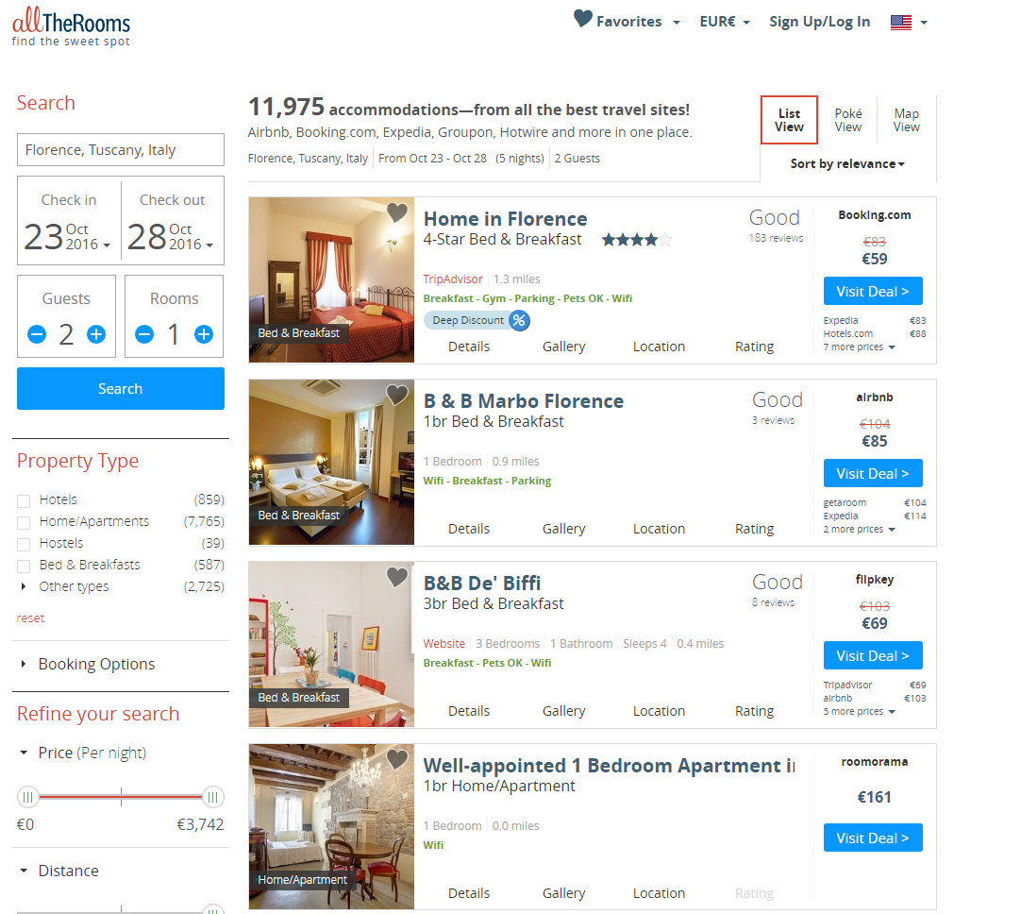
Une application Web moderne

Slide 13
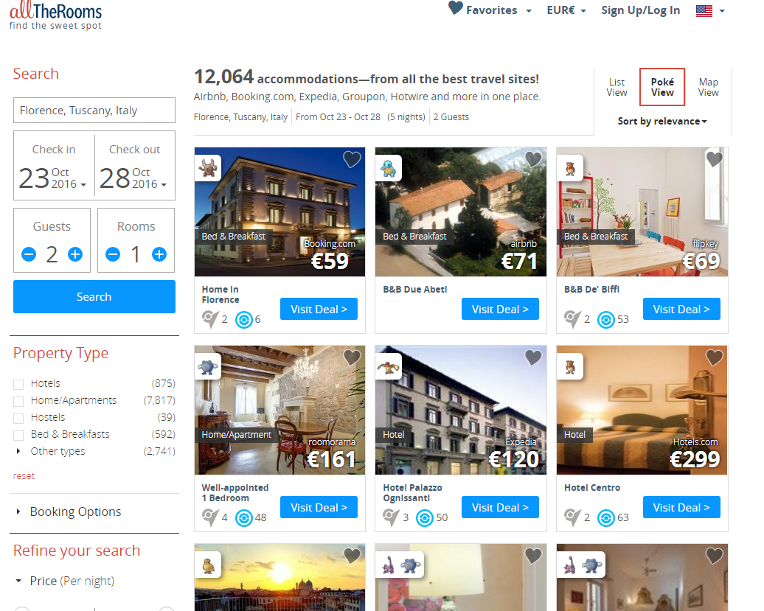
Avec des pokemons

Slide 14
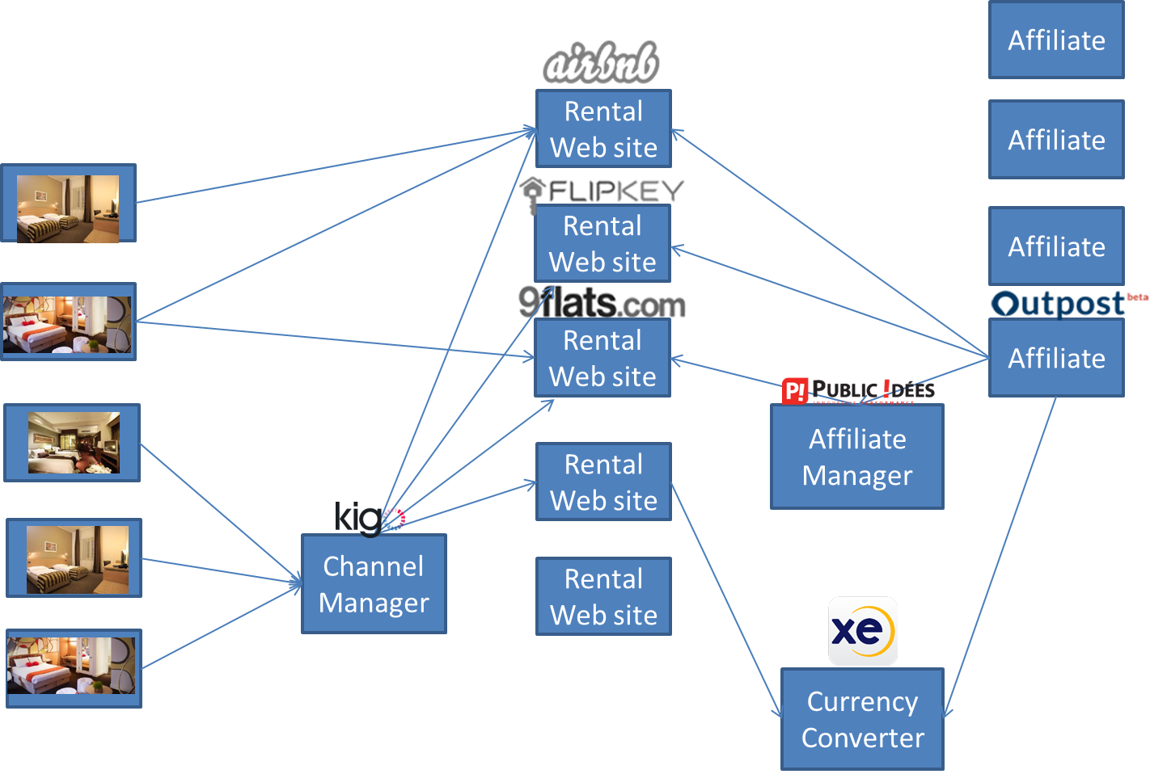

La composition de services
> 1000 sites de location
> 100000 chambres
> 100 pays

Slide 15

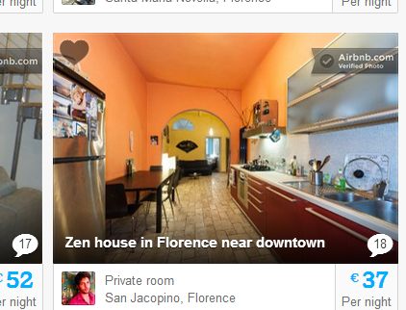

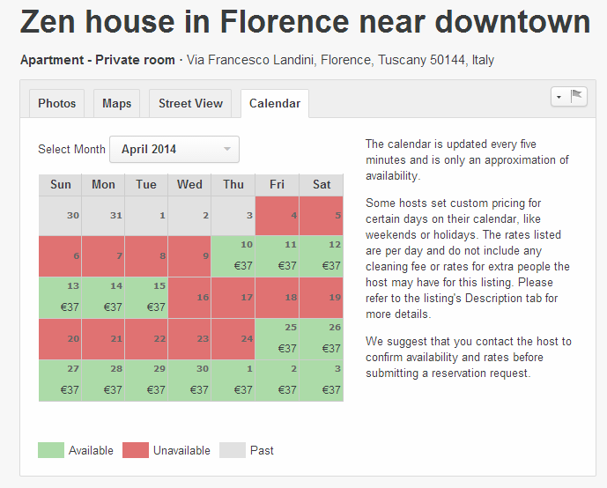
Le partage des données

Slide 16
Exemple revisité et questions ouvertes
Délais
Changement
Contrat
Erreurs
Panne

Slide 17
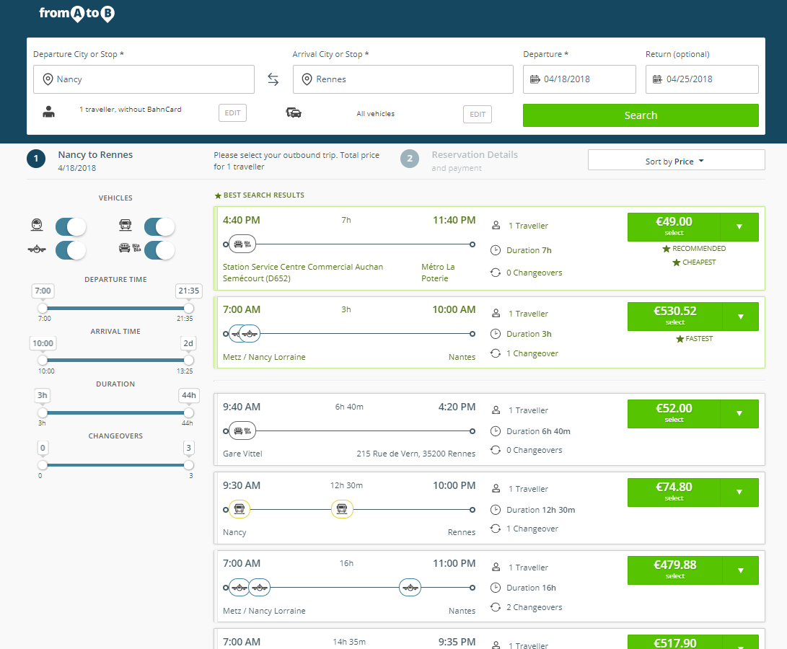



Cloudware - Composition de services
Construction d’applications sans serveur
Sures
Qui passent à l’échelle
Au cout maitrisé
Composition de middleware
Composition d’API

Slide 18
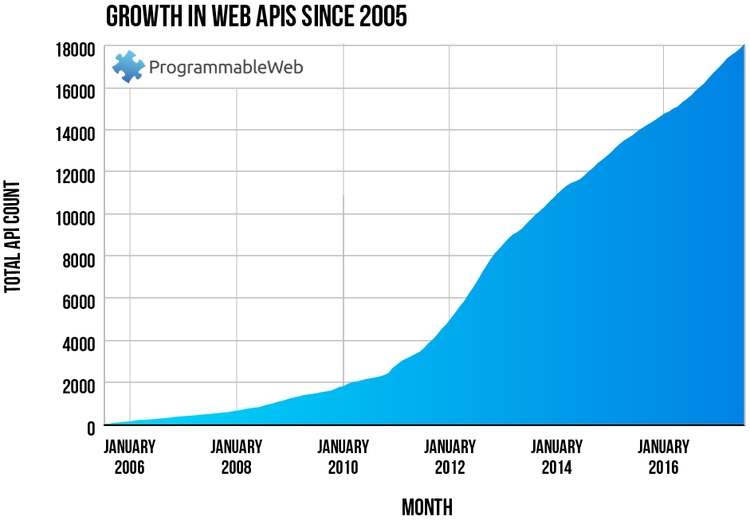
API Growth
https://www.programmableweb.com/news/programmableweb-api-directory-eclipses-17000-api-economy-continues-surge/research/2017/03/13

Slide 19
Service-oriented architecture

Slide 20
Service-oriented architectures
A means of developing distributed systems where the components are stand-alone services
Services may execute on different computers from different service providers
Standard protocols have been developed to support service communication and information exchange

Slide 21
Service-oriented architecture

Slide 22
Benefits of SOA
Services can be provided locally or outsourced to external providers
Services are language-independent
Investment in legacy systems can be preserved
Inter-organisational computing is facilitated through simplified information exchange

Slide 23
Key standards
SOAP
A message exchange standard that supports service communication
WSDL (Web Service Definition Language)
This standard allows a service interface and its bindings to be defined
WS-BPEL
A standard for workflow languages used to define service composition

Slide 24
Web service standards (old style)

Slide 25
Services as reusable components
A service can be defined as:
A loosely-coupled, reusable software component that encapsulates discrete functionality which may be distributed and programmatically accessed. A web service is a service that is accessed using standard Internet and XML-based protocols
A critical distinction between a service and a component as defined in CBSE is that services are independent
Services do not have a ‘requires’ interface
Services rely on message-based communication with messages expressed in XML

Slide 26
Web service description language
The service interface is defined in a service description expressed in WSDL (Web Service Description Language).
The WSDL specification defines
What operations the service supports and the format of the messages that are sent and received by the service
How the service is accessed - that is, the binding maps the abstract interface onto a concrete set of protocols
Where the service is located. This is usually expressed as a URI (Universal Resource Identifier)

Slide 27
Organization of a WSDL specification

Slide 28
WSDL specification components
The ‘what’ part of a WSDL document, called an interface, specifies what operations the service supports, and defines the format of the messages that are sent and received by the service.
The ‘how’ part of a WSDL document, called a binding, maps the abstract interface to a concrete set of protocols. The binding specifies the technical details of how to communicate with a Web service.
The ‘where’ part of a WSDL document describes the location of a specific Web service implementation (its endpoint).

Slide 29
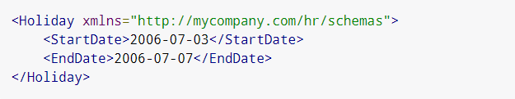
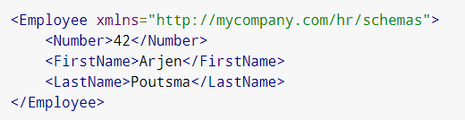
Defining a Web Service
Definition of a web service to book a holiday
First the types
https://docs.spring.io/spring-ws/docs/3.0.3.RELEASE/reference/

Slide 30
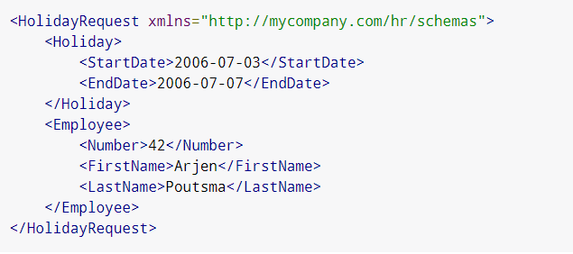
The Request

Slide 31
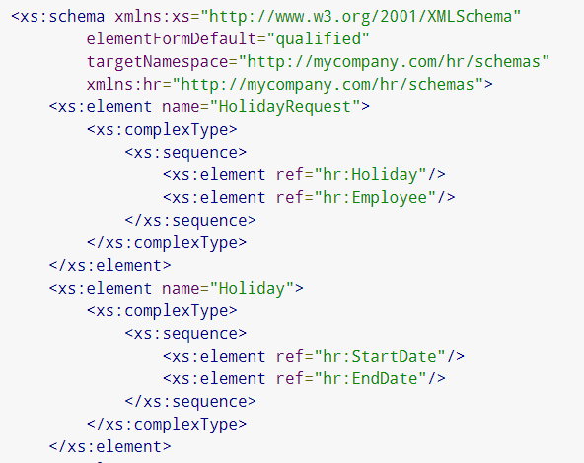
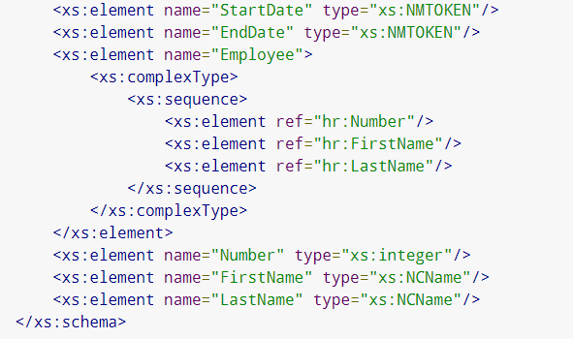
The Data Contract (XSD)

Slide 32
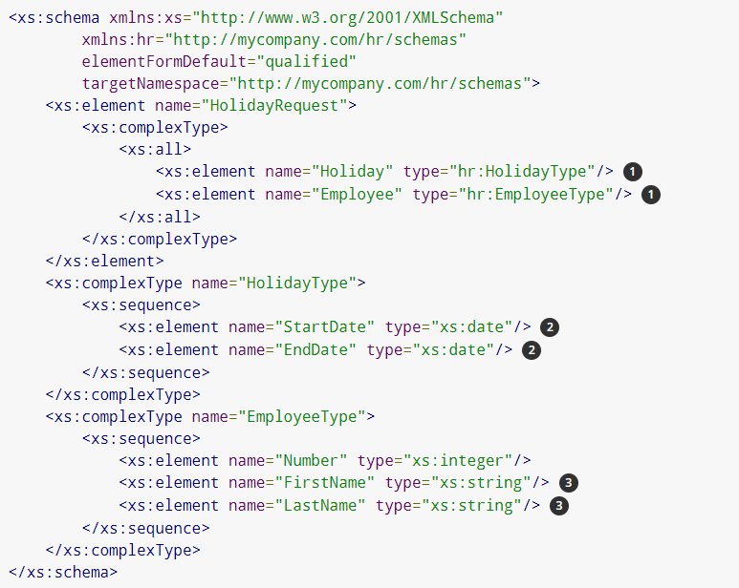
The Data Contract (final)

Slide 33
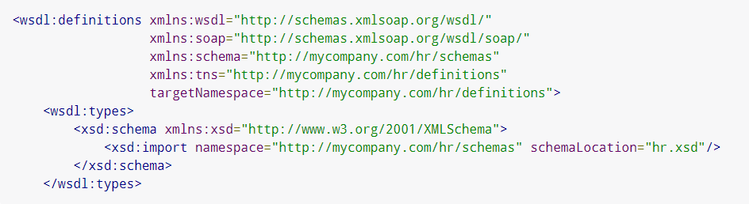
The Service Contract
Describes the abstract interface
Describes the concrete implementation

Slide 34
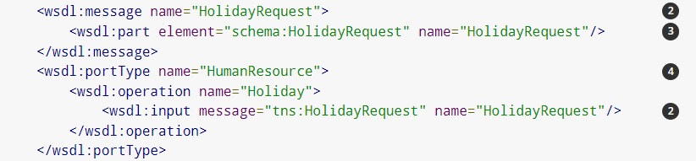
The abstract Part

Slide 35
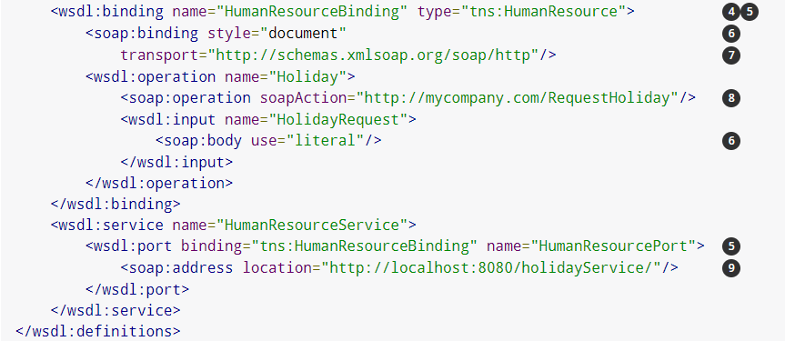
The binding part

Slide 36
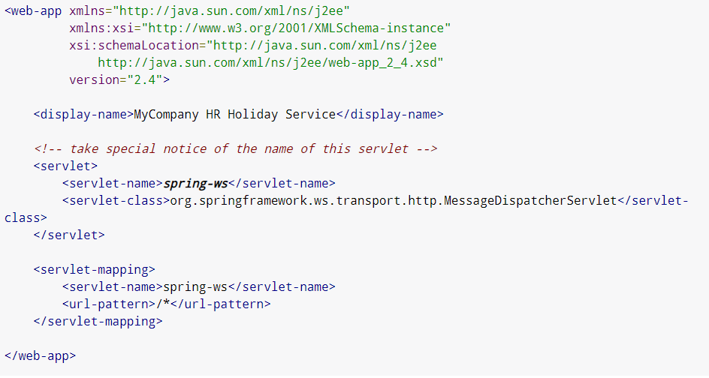
Service Implementation
Implementation as a Web application

Slide 37
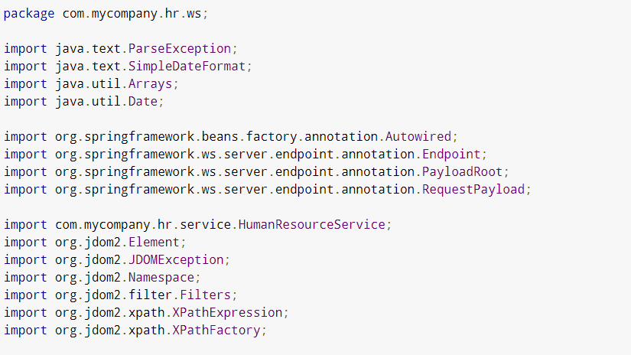
Imports

Slide 38
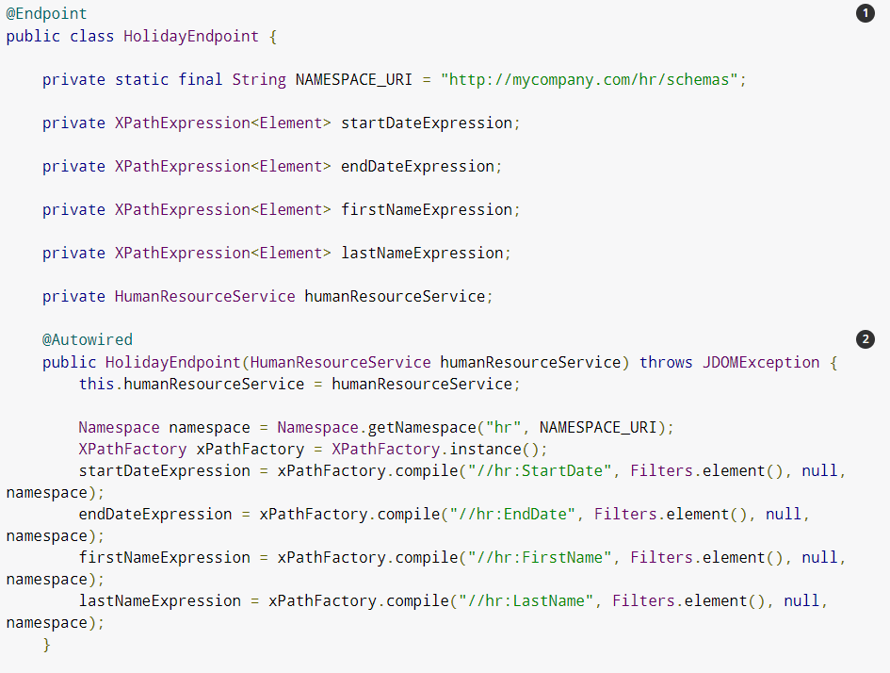

Slide 39
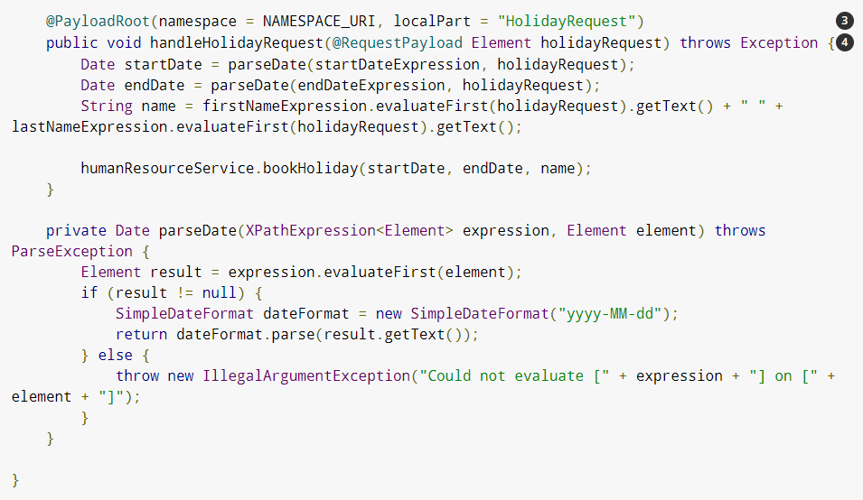

Slide 40
Conclusion on Web services
Identification of service with URI (vs Remote Object Reference)
No Constructor – always on
Used for intra or inter enterprise integration

Slide 41
RESTful services

Slide 42
RESTful web services
Current web services standards have been criticized as ‘heavyweight’ standards that are over-general and inefficient.
REST (REpresentational State Transfer) is an architectural style based on transferring representations of resources from a server to a client.
This style underlies the web as a whole and is simpler than SOAP/WSDL for implementing web services.
RESTful services involve a lower overhead than so-called ‘big web services’ and are used by many organizations implementing service-based systems.

Slide 43
REST is
An acronym from: Representational State Transfer
An architectural style that is derived by applying a set constraints to the elements of a system so the system exhibits certain properties such as loose coupling and scalability
Defined by Roy T. Fielding, PhD in his PhD dissertation, Chapter 5 Representational State Transfer (REST)‏
Data-orientated, “Unlike the distributed object style [31], where all data is encapsulated within and hidden by the processing components, the nature and state of an architecture's data elements is a key aspect of REST” Architectural Styles and the Design of Network-based Software Architectures Roy Thomas Fielding, 2000: PhD dissertation, Chapter 5 Representational State Transfer (REST)

Slide 44
When can I use REST?
For Web Services
build your web service using the REST style
alternative to some of WS-*, not a replacement for WS-*
Clients interfacing to public REST APIs
e.g. Amazon S3 REST API, Google Data APIs
63 percent public APIs have a REST like interface http://www.infoq.com/presentations/Open-API-John-Musser
From Rich Internet Applications (RIAs)‏
client sends AJAX requests to a REST interface using a JavaScript library e.g. jQuery, Dojo (JsonRestStore) or a framework like JavaFX or Silverlight
response (JSON, XML etc) is displayed on the client

Slide 45
I am getting frustrated by the number of people calling any HTTP-based interface a REST API. Today’s example is the SocialSite REST API. That is RPC. It screams RPC. There is so much coupling on display that it should be given an X rating.
Roy Fielding

Slide 46
The REST Constraints cont.
The Uniform interface is
composed of four constraints:
identification of resources
manipulation of resources through representations
self-descriptive messages – meta data & control data
hypermedia as the engine of application state - “the hypertext constraint”, i.e. links in the data for navigation through the application. This is one of the most important constraints

Slide 47
Web uniform interface semantics
RFC2616 specifies HTTP intended method behaviour and semantics for common HTTP methods
Safe: no side-effects, e.g. does not change resource
Idempotent: “the side-effects of N > 0 identical requests is the same as for a single request”
Method | Operation on the resource | Safe | Idempotent
POST | create a new resource as subordinate | No | No
GET | retrieve a resource representation | Yes | Yes
PUT | modify (update) a resource or create a resource at the id | No | Yes
DELETE | delete a resource | No | Yes

Slide 48
URIs and Resources
URI is an ‘address’ of a resource
A resource must have at least one URI
No URI → Not a resource (i.e. it’s really not on the web, so to speak ☺)
URIs should be descriptive (human parseable) and have structure. For Example:
http://www.ex.com/software/releases/latest.tar.gz
http://www.ex.com/map/roads/USA/CA/17_mile_drive
http://www.ex.com/search/cs578
http://www.ex.com/sales/2012/Q1
http://www.ex.com/relationships/Alice;Bob
Notes:
The forward slashes suggest a hierarchical breakdown

Slide 49
REST Principle #1
The key abstraction of information is a resource, named by a URI. Any information that can be named can be a resource

Slide 50
Understanding REST - Statelessness
Every HTTP request happens in complete isolation
Server NEVER relies on information from prior requests
There is no specific ‘ordering’ of client requests (i.e. page 2 may be requested before page 1)
If the server restarts a client can resend the request and continue from it left off
Possible states of a server are also resources and should be given their own URIs!
Notes:
Stateful examples: Disabled ‘back button’ in browser when filling a form etc. that needs to be filled in a specific order and the application disallows you to go to a previous ‘state’ in essence.
Statelessness: Assume that the client requests a document 100 pages long and the server only returns 1 page at a time. To request subsequent pages the client makes more HTTP requests. Each page is a distinct ‘state’ of the application and the URIs could (should) be designed as: www.ex.com/some-long-report?page=10 – this way you may bookmark the state or send it to someone or embed it in a document etc. The user is not forced to view a sequential order of the pages. The ‘state’ of the application (i.e. on page 10) has now been exposed as a resource.

Slide 51
REST Principle #2*
All interactions are context-free: each interaction contains all of the information necessary to understand the request, independent of any requests that may have preceded it.
*RP #3 as per 578 Lecture slides

Slide 52
Understanding REST - Representations
Resources are NOT data – they are an abstraction of how the information/data is split up for presentation/consumption
The web server must respond to a request by sending a series of bytes in a specific file format, in a specific language – i.e. a representation of the resource
Formats: XML/JSON, HTML, PDF, PPT, DOCX...
Languages: English, Spanish, Hindi, Portuguese…

Slide 53
Which Representation to Request?
Style 1: Distinct URI for each representation:
ex.com/press-release/2012-11.en (English)
ex.com/press-release/2012.11.fr (French)
…and so on
Style 2: Content Negotiation
Expose Platonic form URI:
ex.com/press-release/2012-11
Client sets specific HTTP request headers to signal what representations it’s willing to accept
Accept: Acceptable file formats
Accept-Language: Preferred language
Notes:
Both are RESTful and you can pick either one ☺
Style 1:
Pros – easy to know what is being requested and a distinct URI for each representation
Cons – too many URIs
Style 2:
Pros – single URI entry point and everything else part of request metadata i.e. HTTP headers
Cons – A default representation will be returned if the headers are not set properly. Client must know what options to set and what to request

Slide 54
REST Principle #3*
The representation of a resource is a sequence of bytes, plus representation metadata to describe those bytes. The particular form of the representation can be negotiated between REST components
*RP #2 as per 578 Lecture slides

Slide 55
Understanding REST – Uniform Interface
HTTP Provides 4 basic methods for CRUD (create, read, update, delete) operations:
GET: Retrieve representation of resource
PUT: Update/modify existing resource (or create a new resource)
POST: Create a new resource
DELETE: Delete an existing resource
Another 2 less commonly used methods:
HEAD: Fetch meta-data of representation only (i.e. a metadata representation)
OPTIONS: Check which HTTP methods a particular resource supports
Notes:
CRUD = Create, Read, Update, Delete

Slide 56
HTTP Request/Response
Method | Request Entity-Body/Representation | Response Entity-Body/Representation
GET | (Usually) Empty Representation/entity-body sent by client | Server returns representation of resource in HTTP Response
DELETE | (Usually) Empty Representation/entity-body sent by client | Server may return entity body with status message or nothing at all
PUT | (Usually) Client’s proposed representation of resource in entity-body | Server may respond back with status message or with copy of representation or nothing at all
POST | Client’s proposed representation of resource in entity-body | Server may respond back with status message or with copy of representation or nothing at all

Slide 57
PUT vs. POST
POST
Commonly used for creating subordinate resources existing in relation to some ‘parent’ resource
Parent: /weblogs/myweblog
Children: /weblogs/myweblog/entries/1
Parent: Table in DB; Child: Row in Table
PUT
Usually used for modifying existing resources
May also be used for creating resources
PUT vs. POST (for creation)
PUT: Client is in charge of deciding which URI resource should have
POST: Server is in charge of deciding which URI resource should have

Slide 58
PUT vs. POST (Cont’d)
What in case of partial updates or appending new data? PUT or POST?
PUT states: Send completely new representation overwriting current one
POST states: Create new resource
In practice:
PUT for partial updates works fine. No evidence/claim for ‘why’ it can’t (or shouldn’t) be used as such (personal preference)
POST may also be used and some purists prefer this

Slide 59
REST Principle #4
Components perform only a small set of well-defined methods on a resource producing a representation to capture the current or intended state of that resource and transfer that representation between components. These methods are global to the specific architectural instantiation of REST; for instance, all resources exposed via HTTP are expected to support each operation identically

Slide 60
Understanding REST – Safety & Idempotence
When correctly used GET and HEAD requests are safe and GET, HEAD, PUT, DELETE are idempotent. POST is neither safe nor idempotent
Safety: The request doesn’t change server state i.e. no side effects → no changing state of resource
Making 10 requests is same as making one or none at all
Idempotence: Executing the same operation multiple times is the same as executing it once
Deleting an already DELETE-ed resource is still deleted
Updating an already updated resource with PUT has no effect

Slide 61
Safety and Idempotence
Why do they matter?
Lets a client make reliable HTTP requests over an unreliable connection
If no response then just reissue the request
Some common mistakes/misuses:
GET https://some.api.com/item/delete
(Overloaded )POST https://some.api.com/item
Entity-body: Method=fetch
Or setting different query parameters
Basically using POST for everything ☺

Slide 62
REST Principle #5
Idempotent operations and representation metadata are encouraged in support of caching and representation reuse.

Slide 63
REST Principle #6
The presence of intermediaries is promoted. Filtering or redirection intermediaries may also use both the metadata and the representations within requests or responses to augment, restrict, or modify requests and responses in a manner that is transparent to both the user agent and the origin server.

Slide 64
Steps to a RESTful Architecture
Read the Requirements and turn them into resources ☺
Figure out the data set
Split the data set into resources
For each kind of resource:
Name resources with URIs
Expose a subset of uniform interface
Design representation(s) accepted from client (Form-data, JSON, XML to be sent to server)
Design representation(s) served to client (file-format, language and/or (which) status message to be sent)
Consider typical course of events: sunny-day scenarios
Consider alternative/error conditions: rainy-day scenarios

Slide 65
HTTP Status/Response Codes
HTTP is built in with a set of status codes for various types of scenarios:
2xx Success (200 OK, 201 Created…)
3xx Redirection (303 See other)
4xx Client error (404 Not Found)
5xx Server error (500 Internal Server Errror)
Leverage existing status codes to handle sunny/rainy-day scenarios in your application!

Slide 66
Points to Note
Authentication/Authorization data sent with every request
Sessions are NOT RESTful (i.e. sessions = state)
Cookies, if used appropriately (for storing client state) are RESTful
100% RESTful architecture is not practical and not valuable either
Need to be unRESTful at times (Eg.: Login/Logout)
These are actions and not a resource per se
Usually POST requests sent to some URI for logging in/out
Advantages: Gives login page, provides ability of “Forgot your password” type functionalities etc.
Benefits of UnRESTful-ness outweigh adherence to style
Some server frameworks only support GET/POST forcing one to overload POST requests for PUT/DELETE

Slide 67
Benefits of RESTful Design
Simpler and intuitive design – easier navigability
Server doesn’t have to worry about client timeout
Clients can easily survive a server restart (state controlled by client instead of server)
Easy distribution – since requests are independent they can be handled by different servers
Scalability: As simple as connecting more servers ☺
Stateless applications are easier to cache – applications can decide which response to cache without worrying about ‘state’ of a previous request
Bookmark-able URIs/Application States
HTTP is stateless by default – developing applications around it gets above benefits (unless you wish to break them on purpose ☺)

Slide 68
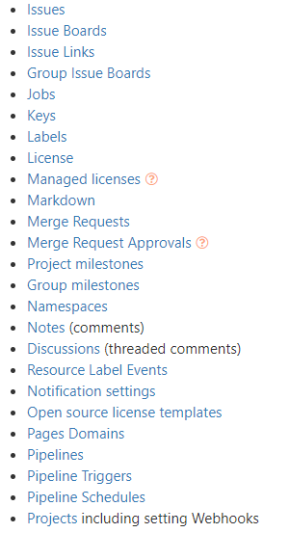
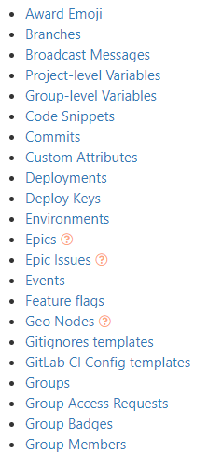
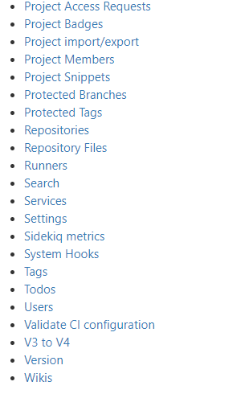
The Gitlab API

Slide 69
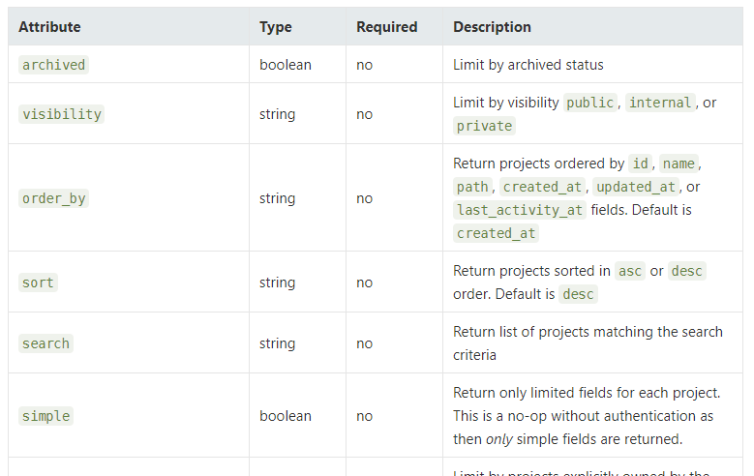
Projects resource
https://docs.gitlab.com/ee/api/projects.html

Slide 70
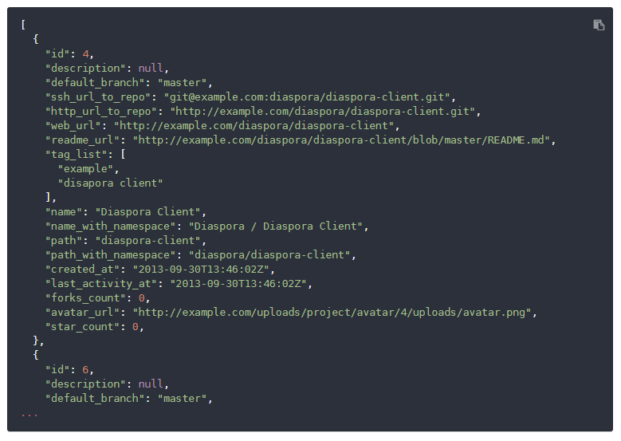
Request when not authenticated

Slide 71
List User Projects
https://docs.gitlab.com/ee/api/projects.html#list-user-projects

Slide 72

Get a single project
https://docs.gitlab.com/ee/api/projects.html#get-single-project

Slide 73
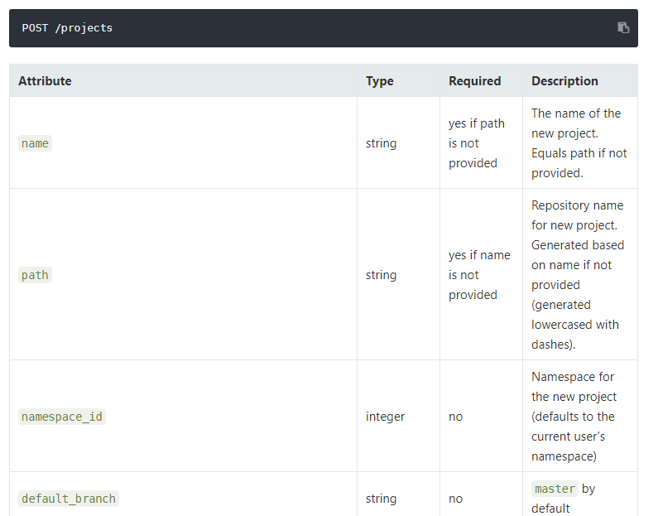
Create a project

Slide 74
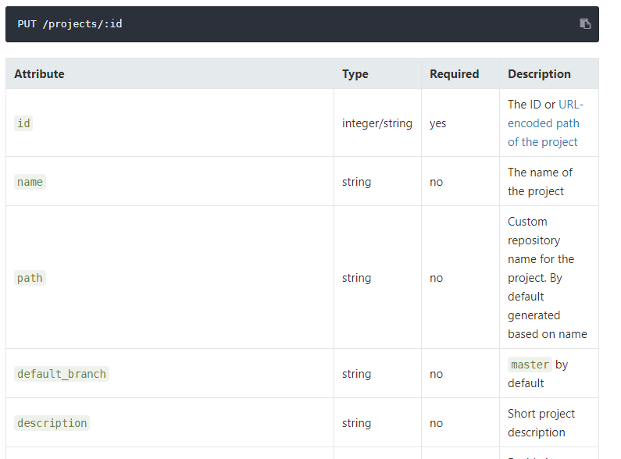
Edit project

Slide 75
Spring example
Version basique
Pas vraiment Restful

Slide 76
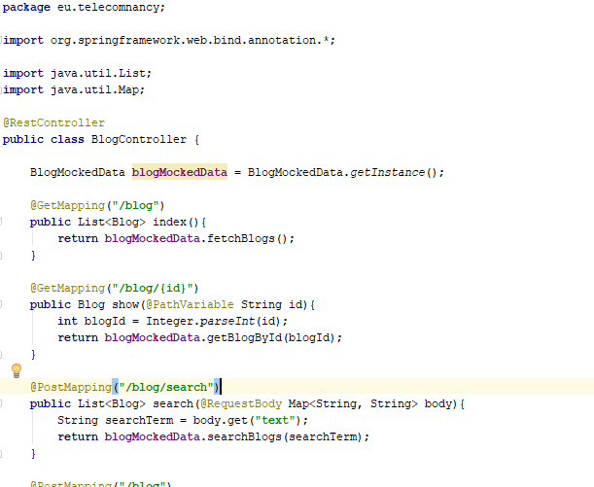
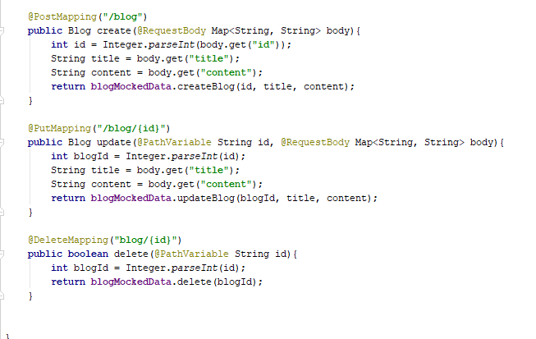
Rest et Spring – le controller
https://medium.com/@salisuwy/building-a-spring-boot-rest-api-a-php-developers-view-part-i-6add2e794646

Slide 77
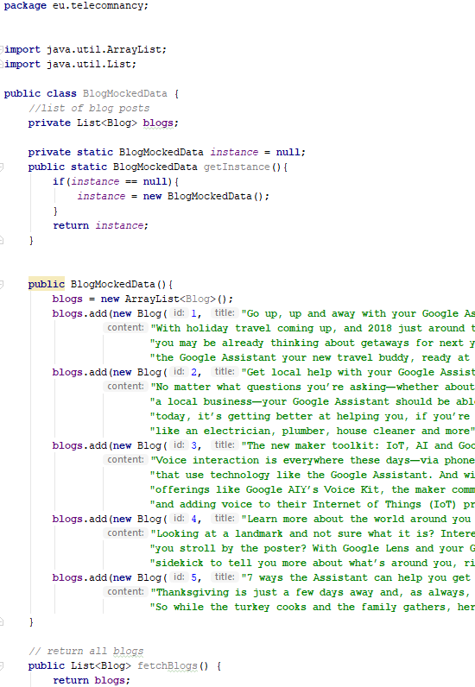
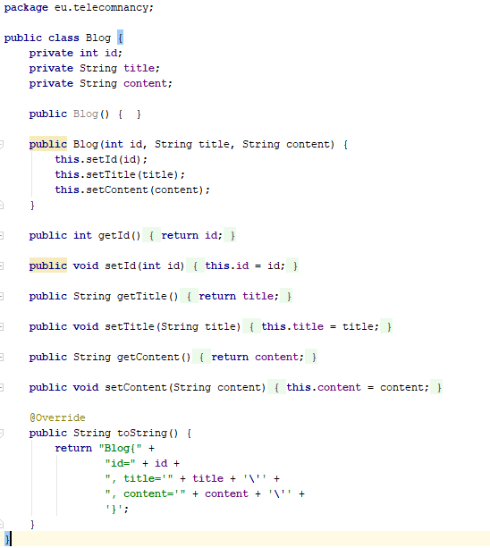

Slide 78
Worked examples
For other examples see the references
How to GET a Cup of Coffee by Jim Webber, Savas Parastatidis & Ian Robinson Oct 02, 2008
http://www.infoq.com/articles/webber-rest-workflow
msdn, A Guide to Designing and Building RESTful Web Services with WCF 3.5, Aaron Skonnard, Oct 2008
http://msdn.microsoft.com/en-us/library/dd203052.aspx
Using REST to aid WS-* - building a RESTful SOA Registry
http://www.infoq.com/presentations/rest-soa-registry

Slide 79
REST vs SOA
Business IT vs WWW
REST is coupled to HTTP
REST is well suited for API
Difficult to identify ressources for REST
SOA is more interoperable
It’s changing with RAML, Swagger and OpenAPI 3.0
It’s changing with GraphQL

Slide 80

Open API (aka Swagger)
Standardize the Description of API
Donation of Swagger to a consortium

Slide 81
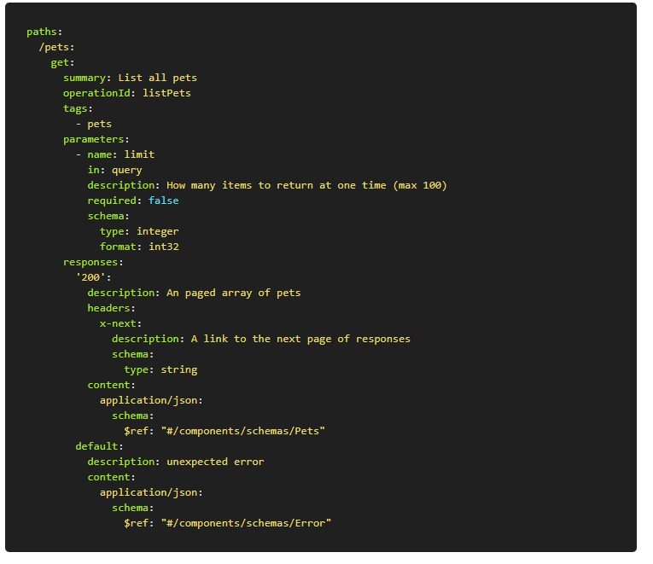

Slide 82
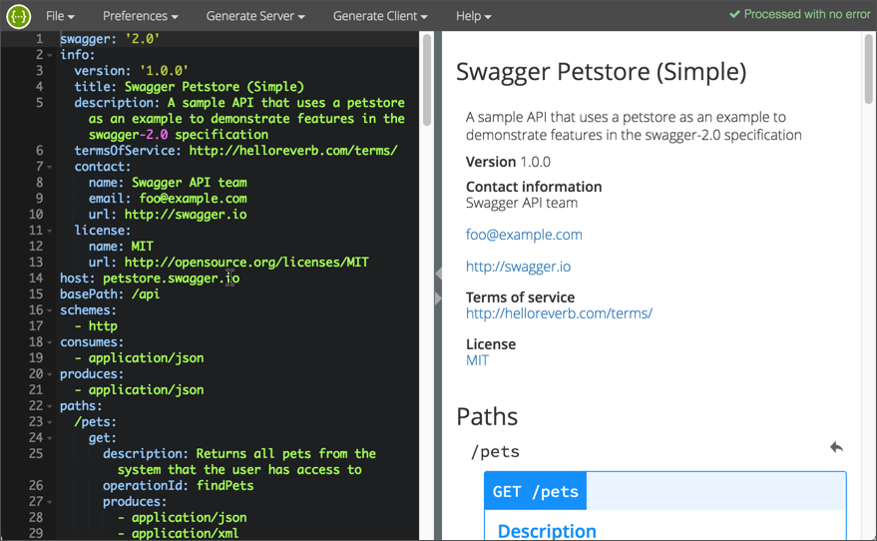
Swagger editor

Slide 83
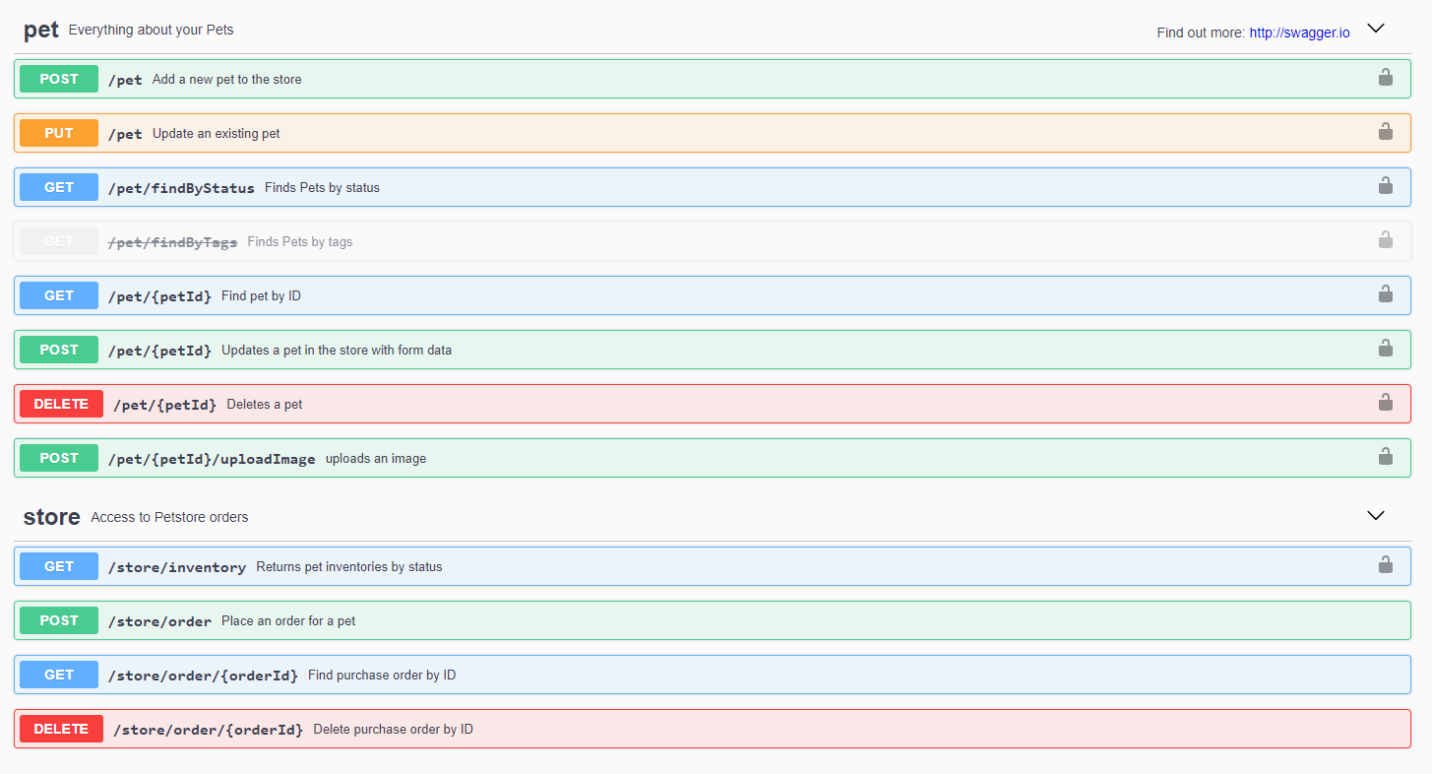
Pet Store example

Slide 84
SwaggerHub
https://app.swaggerhub.com/apis/IdRatherBeWriting/open-weather_map_api/2.5.2

Slide 85
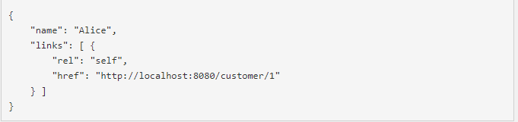
Hateos : towards full Restful API
Hypermedia as the Engine of Application State
Responses contains hypermedia links

Slide 86
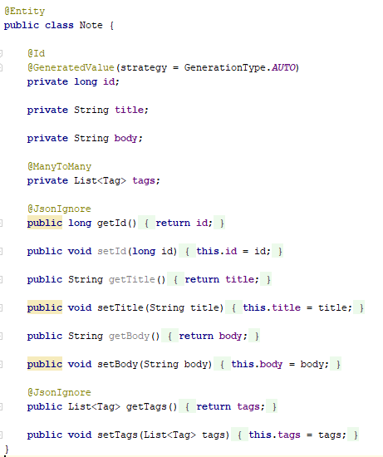
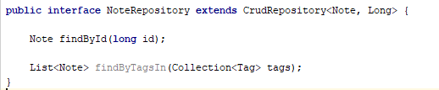
Exemple

Slide 87
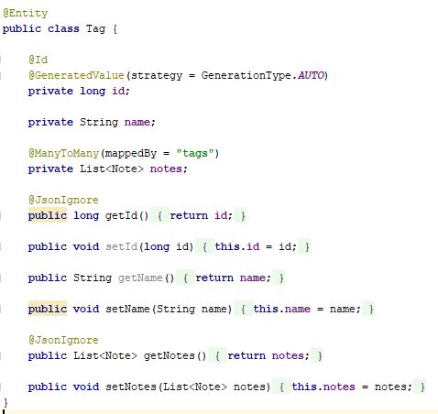
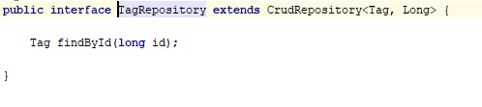

Slide 88
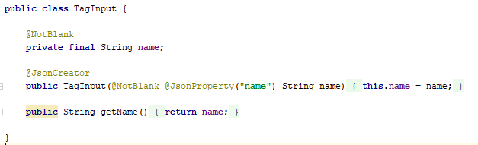

Slide 89
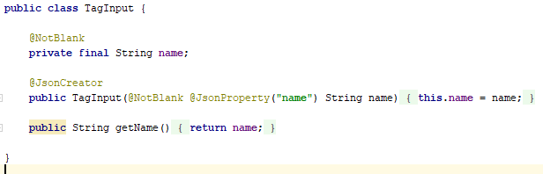
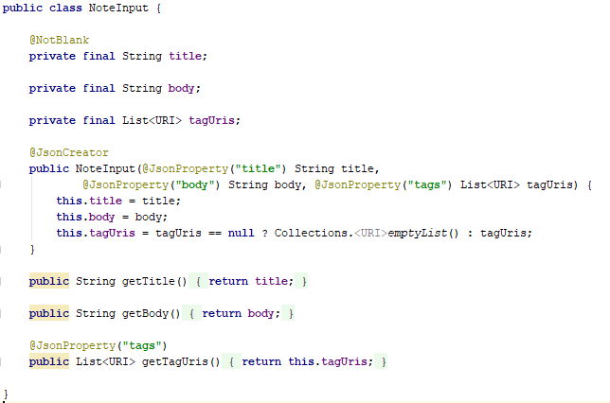
Input models

Slide 90
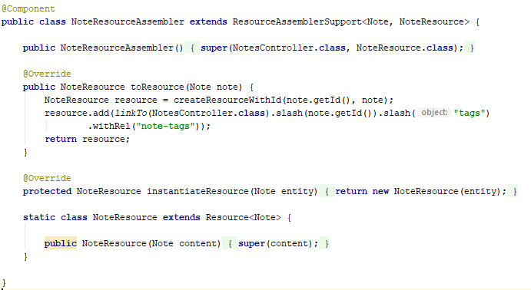
Resource Assembler

Slide 91
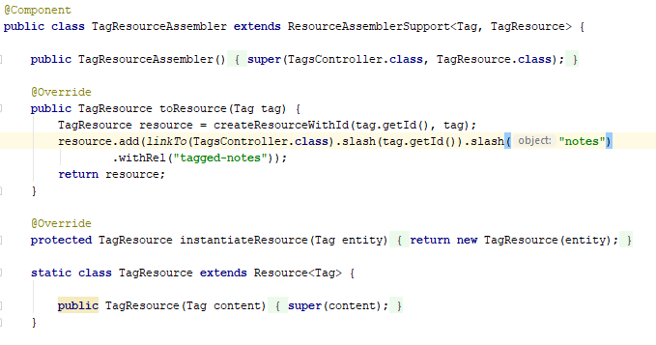
Resource Assembler

Slide 92
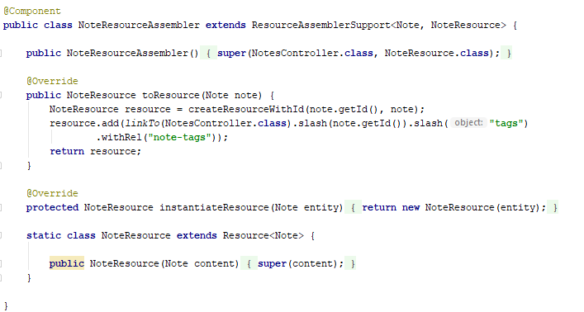
Resource Assembler

Slide 93
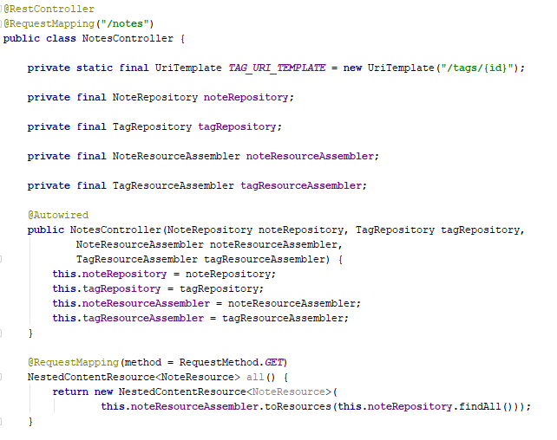

Slide 94
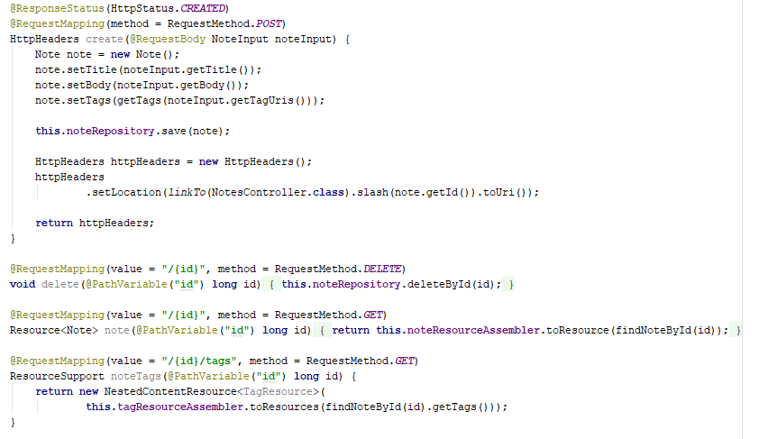

Slide 95
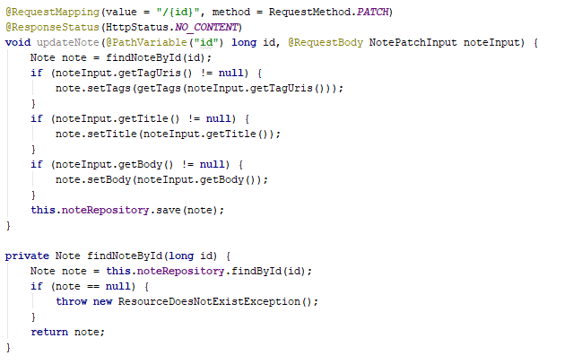

Slide 96
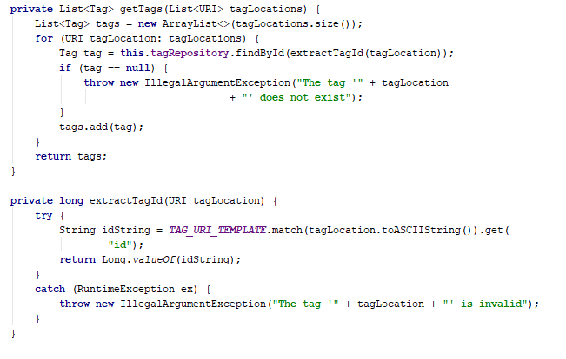

Slide 97
Service composition

Slide 98
Software development with services
Existing services are composed and configured to create new composite services and applications
The basis for service composition is often a workflow
Workflows are logical sequences of activities that, together, model a coherent business process
For example, provide a travel reservation services which allows flights, car hire and hotel bookings to be coordinated

Slide 99
Vacation package workflow

Slide 100
Service construction by composition

Slide 101
Construction by composition
Formulate outline workflow
In this initial stage of service design, you use the requirements for the composite service as a basis for creating an ‘ideal’ service design.
Discover services
During this stage of the process, you search service registries or catalogs to discover what services exist, who provides these services and the details of the service provision.
Select possible services
Your selection criteria will obviously include the functionality of the services offered. They may also include the cost of the services and the quality of service (responsiveness, availability, etc.) offered.

Slide 102
Construction by composition
Refine workflow.
This involves adding detail to the abstract description and perhaps adding or removing workflow activities.
Create workflow program
During this stage, the abstract workflow design is transformed to an executable program and the service interface is defined. You can use a conventional programming language, such as Java or a workflow language, such as WS-BPEL.
Test completed service or application
The process of testing the completed, composite service is more complex than component testing in situations where external services are used.

Slide 103
Workflow design and implementation
WS-BPEL is an XML-standard for workflow specification. However, WS-BPEL descriptions are long and unreadable
Graphical workflow notations, such as BPMN, are more readable and WS-BPEL can be generated from them
In inter-organisational systems, separate workflows are created for each organisation and linked through message exchange.
Workflows can be used with both SOAP-based and RESTful services.

Slide 104
A fragment of a hotel booking workflow

Slide 105
Interacting workflows

Slide 106
Testing service compositions
Testing is intended to find defects and demonstrate that a system meets its functional and non-functional requirements.
Service testing is difficult as (external) services are ‘black-boxes’. Testing techniques that rely on the program source code cannot be used.

Slide 107
Service testing problems
External services may be modified by the service provider thus invalidating tests which have been completed.
Dynamic binding means that the service used in an application may vary - the application tests are not, therefore, reliable.
The non-functional behaviour of the service is unpredictable because it depends on load.
If services have to be paid for as used, testing a service may be expensive.
It may be difficult to invoke compensating actions in external services as these may rely on the failure of other services which cannot be simulated.

Slide 108
Key points
Service-oriented architecture is an approach to software engineering where reusable, standardized services are the basic building blocks for application systems.
Services may be implemented within a service-oriented architecture using a set of XML-based web service standards. These include standards for service communication, interface definition and service enactment in workflows.
Alternatively, a RESTful architecture may be used which is based on resources and standard operations on these resources.
A RESTful approach uses the http and https protocols for service communication and maps operations on the standard http verbs POST, GET, PUT and DELETE.

Slide 109
Key points
Utility services provide general-purpose functionality; business services implement part of a business process; coordination services coordinate service execution.
Service engineering involves identifying candidate services for implementation, defining service interfaces and implementing, testing and deploying services.
The development of software using services involves composing and configuring services to create new composite services and systems.
Graphical workflow languages, such as BPMN, may be used to describe a business process and the services used in that process.

